Slide 1
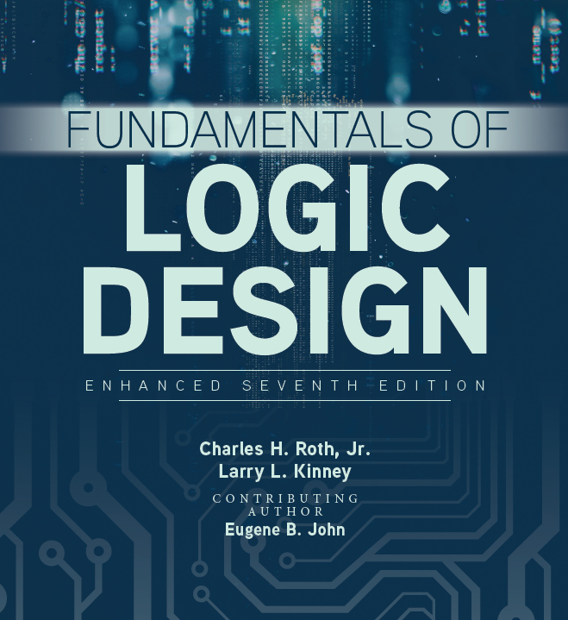

Unit 3
Boolean Algebra (continued)

Slide 2
This chapter includes:
3.1 Multiplying out and Factoring Expressions
3.2 Exclusive-OR and Equivalence Operations
3.3 The Consensus Theorem
3.4 Algebraic Simplification of Switching Expressions
3.5 Proving Validity of an Equation

Slide 3

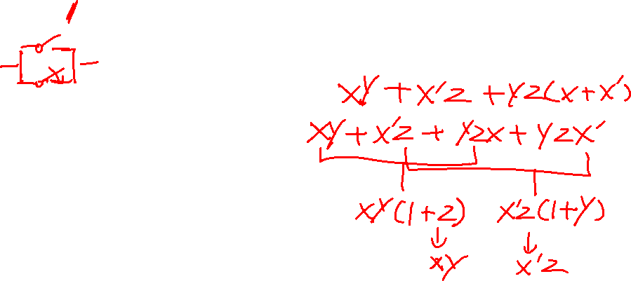
The Consensus Theorem
Consensus Theorem:
The consensus theorem is used to cancel out redundant terms in an expression and is stated below:
The term that is eliminated can be called the consensus term.
The dual form of the consensus theorem is:

Slide 4
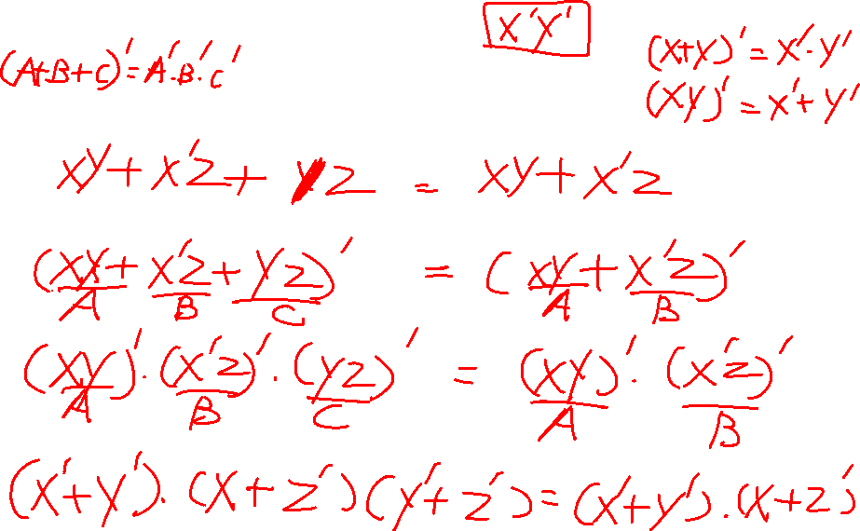
Proof for duality

Slide 5


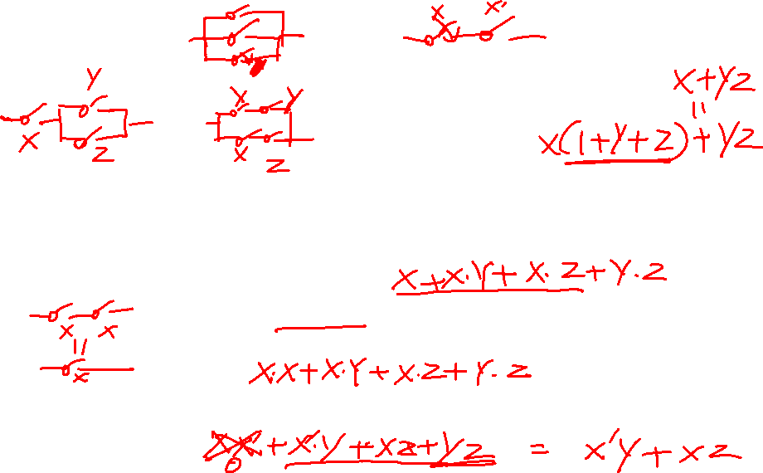
Multiplying out and Factoring Expressions
Given an expression in product-of-sums form, the corresponding sum-of-products expression can be obtained by multiplying out, using the two distributive laws:
In addition, the following theorem is very useful for factoring and multiplying out:

Slide 6
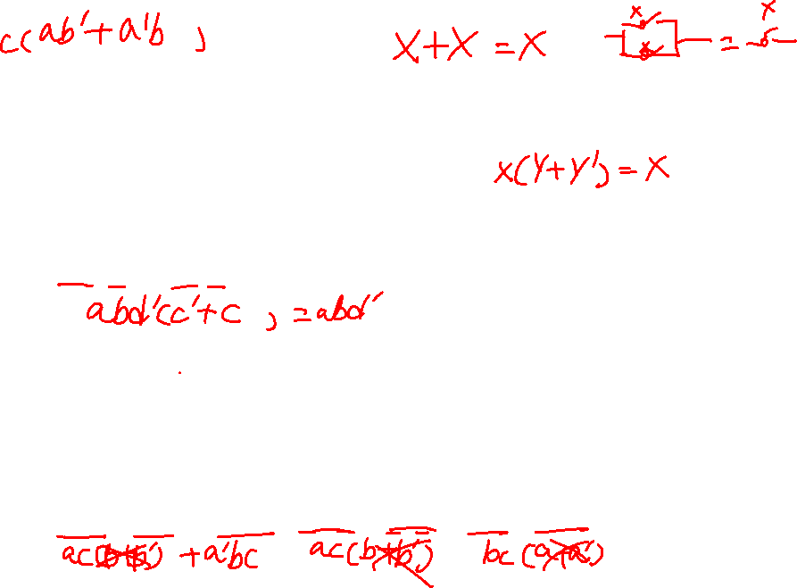
Algebraic Simplification of Switching Expressions
Combining Terms:
1. Combining terms. Use the theorem XY + XY’ = X to combine two terms. For example,
abc'd’ + abcd’ = abd’ [X = abd’, Y = c] (3-24)
When combining terms by this theorem, the two terms to be combined should contain exactly the same variables, and exactly one of the variables should appear complemented in one term and not in the other. Because X + X = X, a given term may be duplicated and combined with two or more other terms. For example,
ab'c + abc + a’bc = ab’c + abc + abc + a’bc = ac + bc

Slide 7
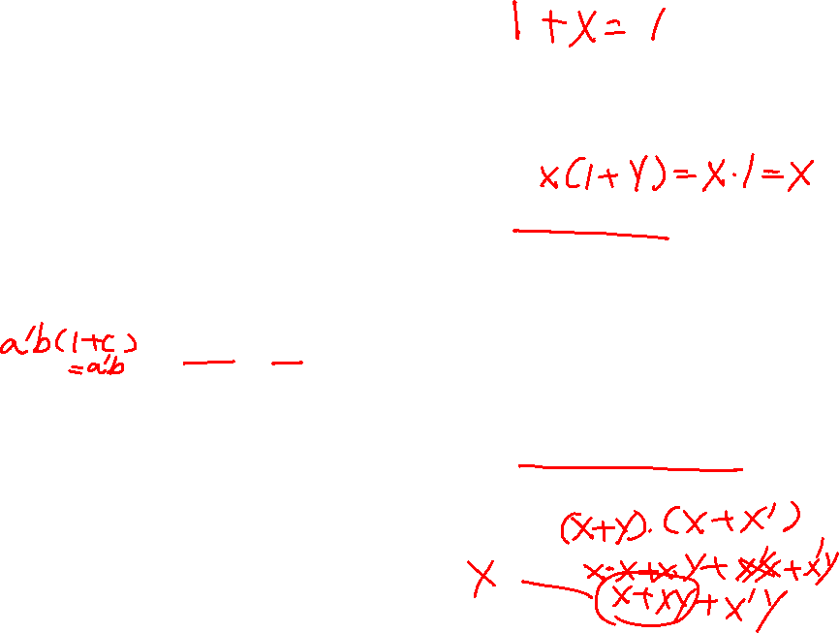
1. Combining terms. Use the theorem XY + XY’ = X to combine two terms. For example,
abc'd’ + abcd’ = abd’ [X = abd’, Y = c] (3-24)
Eliminating Terms and Literals:
2. Eliminating terms. Use the theorem X + XY = X to eliminate redundant terms if possible; then try to apply the consensus theorem (XY + X’Z + YZ = XY + X’Z) to eliminate any consensus terms. For example,
a'b + a‘bc = a‘b [X = a‘b]
a'bc’ + bcd + a’bd = a’bc’ + bcd [X = c, Y = bd, Z = a’b] (3-25)
3. Eliminating literals. Use the theorem X + X’Y = X + Y to eliminate redundant literals. Simple factoring may be necessary before the theorem is applied.

Slide 8
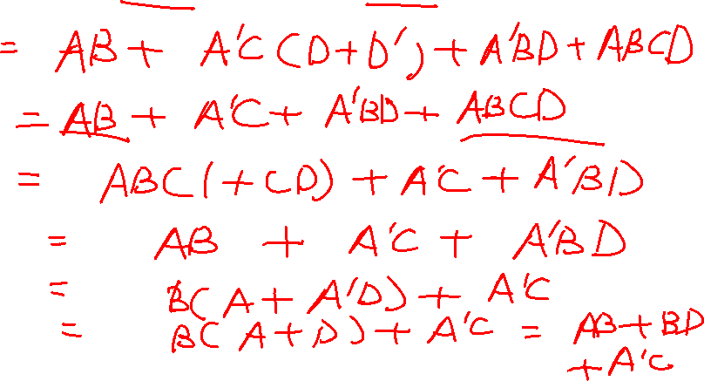
Simplification example
Expressed in sum of product, 3 terms 6 literals

Slide 9
Proving the Validity of an Equation
Proving an equation is valid:
To determine if an equation is valid, meaning valid for all combinations of values of the variables, several methods can be used:
1. Construct a truth table and evaluate both sides of the equation for all combinations
of values of the variables.
2. Manipulate one side of the equation by applying various theorems until it is
identical with the other side.

Slide 10
Proving the Validity of an Equation
Proving an Equation is valid (continued):
3. Reduce both sides of the equation independently to the same expression.
4. It is permissible to perform the same operation on both sides of the equation
provided that the operation is reversible.

Slide 11
Proving the Validity of an Equation
To prove an equation is NOT valid:
To prove that an equation is not valid, it is sufficient to show one combination of values of the variables for which the two sides of the equation have different values.
1. First reduce both sides to a sum of products (or a product of sums).
2. Compare the two sides of the equation to see how they differ.
3. Then try to add terms to one side of the equation that are present on the other side.
4. Finally try to eliminate terms from one side that are not present on the other.
Whatever method is used, frequently compare both sides of the equation and let the difference between them serve as a guide for what steps to take next.

Slide 12
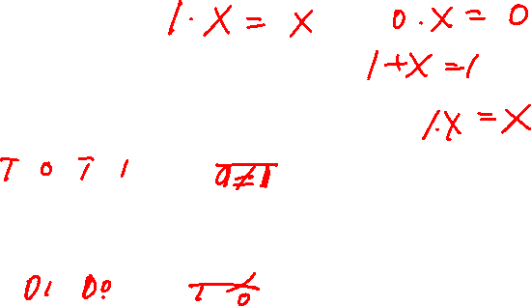
Proving the Validity of an Equation
Cancellation Laws in Boolean Algebra:
The cancellation law for ordinary algebra, where:
If x+y=x+z then y=z
Does not hold for Boolean algebra.
The cancellation law for multiplication, where:
If xy=xz then y=z
Does not hold for Boolean algebra.
However, the converses of these hold true:

Slide 13
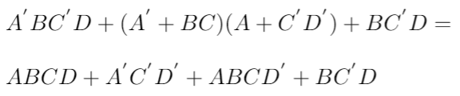
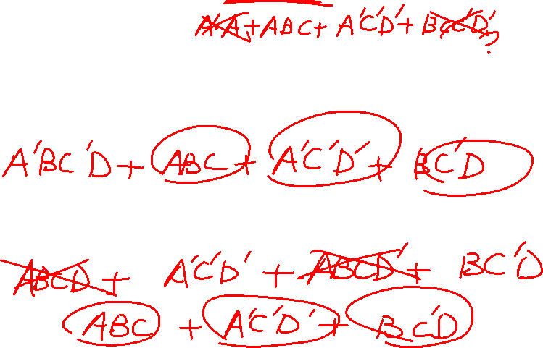
Prove validity example

